Slide 1
Hubspace Product Note

Slide 2
What is Hubspace
Organizations today use multiple business tools in their workspace to manage their businesses
For example :
ERP : SAP , Zoho Books, Tally, Quikbooks, Netsuite
CRM : Sales force, HubSpot
HRMS : Darwin Box, Oracle People Soft
Developers : Github, Jira
Product Managers : Figma, Notion
Colloboration : Slack
Marketing : Facebook, Google campaign manager, Google Analytics
Excel, Slack, Google sheet, Google workspace, Gmail
MySQL, AWS, Snowflake
The above systems are not interconnected with each other resulting in
Siloed Data
Lack of visibility into data
Lack of analytics, insights
Inability to collaborate and take data-driven insights from these fragmented business systems

Slide 3
What is Hubspace
Hubspace is an AI-driven connected workspace that lets businesses connect all their internal and external businesses systems into one unified platform where they can search, get analytics & insights, run their operations and collaborate.
In Hubspace, a business can create multiple spaces by connecting relevant data sources or business systems within minutes and then search anything on the space, get insights by creating custom dashboards and analytics and collaborate with internal of external teams. Users can also Apps ( AI based productivity tools which enables them to perform a function within their spaces).
Example : A finance team could create a space on Hubspace called “ Finance Operations” by connecting datasources like Google Sheets, SAP, Stripe payment gateway and then use the intelligent search function to search for any data like “ Tell me the list of pending dues more than 30 days from customers” or perform an action like “ reconcile my bank statement with Stripe payment gateway”. Further the business can create custom dashboards instantly using text ( example “Create a chart of daily sales by region excluding bangalore”) which gets updated on a real time basis. Apart from this users could multiple apps to their space ( example : A recon app that performs recon for finance or an OCR application that auto-reads bills to perform a function or a scenario planning app that uses the connected data to offer scenario planning).

Slide 4
Product flow ( high level)
Register on hubspace.co
Signup for trial
Create first Space
- Give a name to the space
- Add integrations
Space
- Search
- Dashboards & Insights ( Create and pin)
- Apps

Slide 5
Registeration

Slide 6
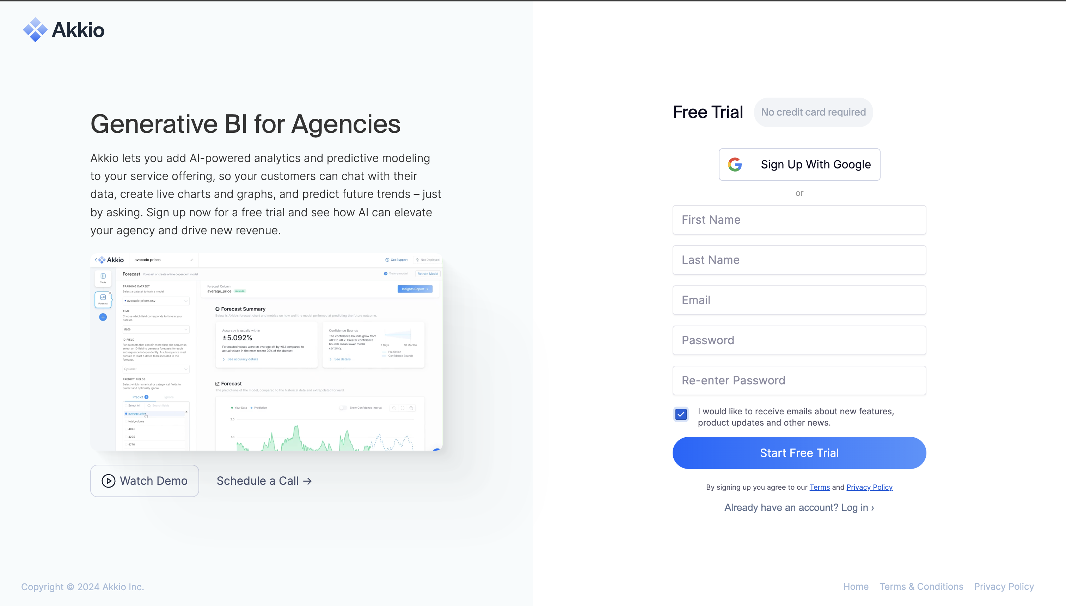


Slide 7
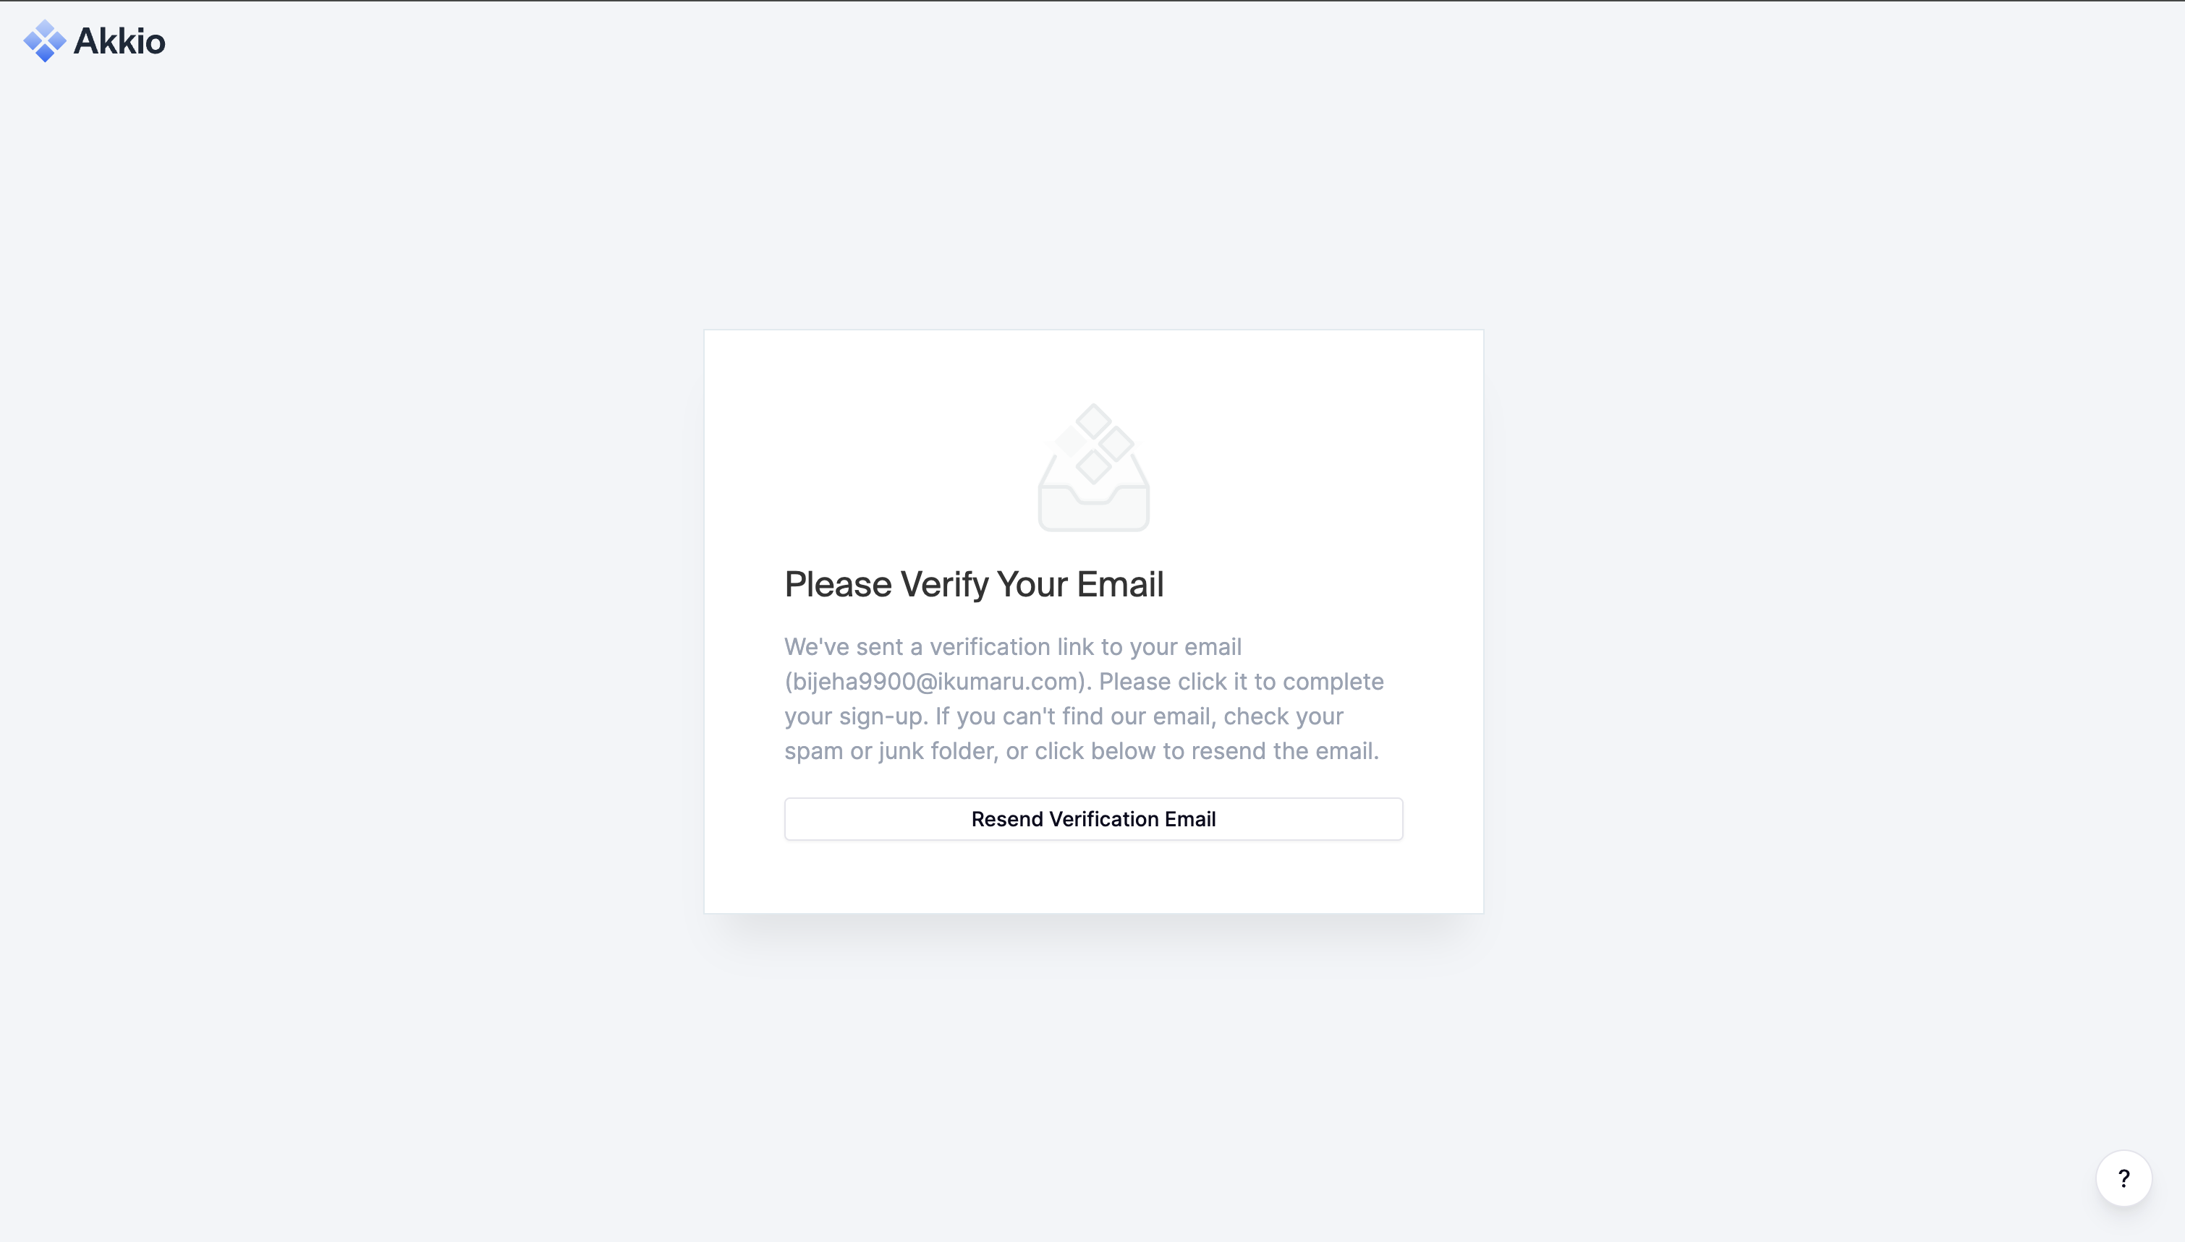

Slide 8
Select your industry
Accounting
Continue

Slide 9
Select your industry
Other
Continue

Slide 10
Industries in drop down list
Description of Options:
Accounting
Advertising & Marketing
Aerospace & Defense
Agriculture
Automotive
Banking
Biotechnology
Construction
Consulting
Education
Energy
Engineering
Entertainment & Media
Financial Services
Food & Beverage
Government
Healthcare
Hospitality
Insurance
Legal
Manufacturing
Nonprofit
Pharmaceutical
Real Estate
Retail
Software & Technology
Telecommunications
Transportation & Logistics
Utilities
Other
If others provide an option to specify

Slide 11
Select your role in the company
CEO/Founder
Continue

Slide 12
Select your role in the company
Other
Continue

Slide 13
Select your Role in the company ( Op
Operations Manager
Project Manager
Supply Chain Manager
Logistics Coordinator
Accountant
Financial Analyst
ControllerHuman Resources:
HR Generalist
HR Manager
Talent Acquisition Specialist
IT Administrator
Technical Support Specialist
Network Engineer
Legal Counsel
Compliance Officer
Contract Manager
Consultant
Advisor
Analyst
Freelancer
Student
Other (with an option for users to specify)
CEO/Founder
COO (Chief Operating Officer)
CFO (Chief Financial Officer)
CTO (Chief Technology Officer)
CMO (Chief Marketing Officer)
CIO (Chief Information Officer)
CHRO (Chief Human Resources Officer)
General Manager
Director
Manager
Team Lead
Sales and Marketing:
Sales Representative
Sales Manager
Marketing Coordinator
Marketing Manager
Digital Marketing Specialist
Social Media Manager
Customer Success:
Customer Success Manager
Account Manager
Support Specialist
Implementation Specialist
Product and Development:
Product Manager
Software Engineer
UX/UI Designer
Quality Assurance Engineer
Data Analyst

Slide 14
Select your company Size
Small ( 1 – 50 employees)
Medium ( 51 – 250 employees)
Large ( 251 – 1001 employees)
Enterprise ( 1001+ employees)
Continue

Slide 15
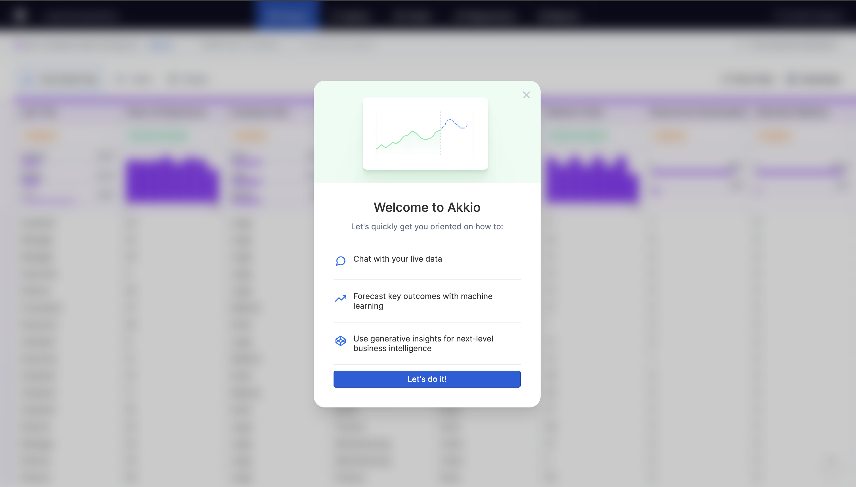
Welcome to Hubspace
Let's go through a demo space to see
Get insights & analytics through custom dashboards

Slide 16
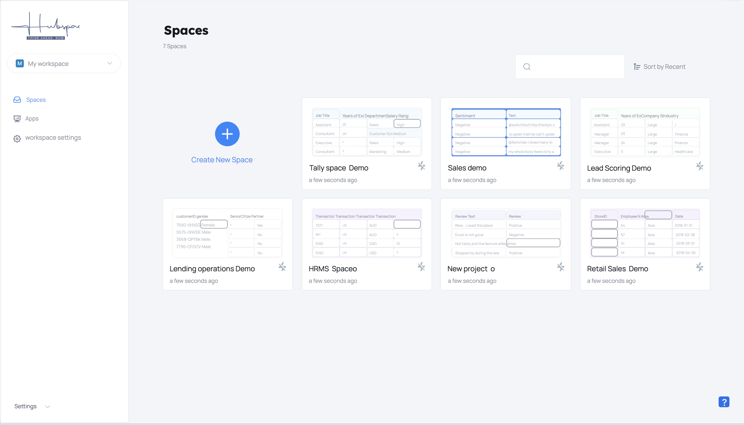
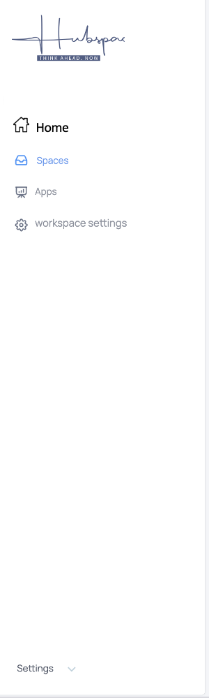
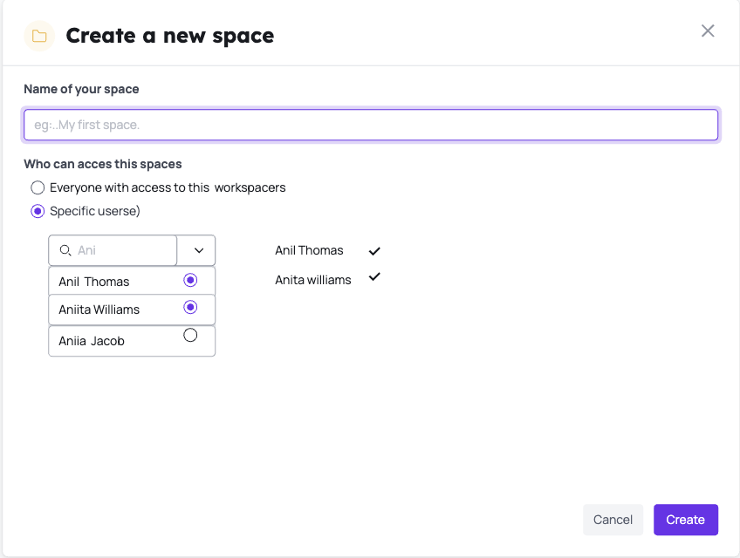
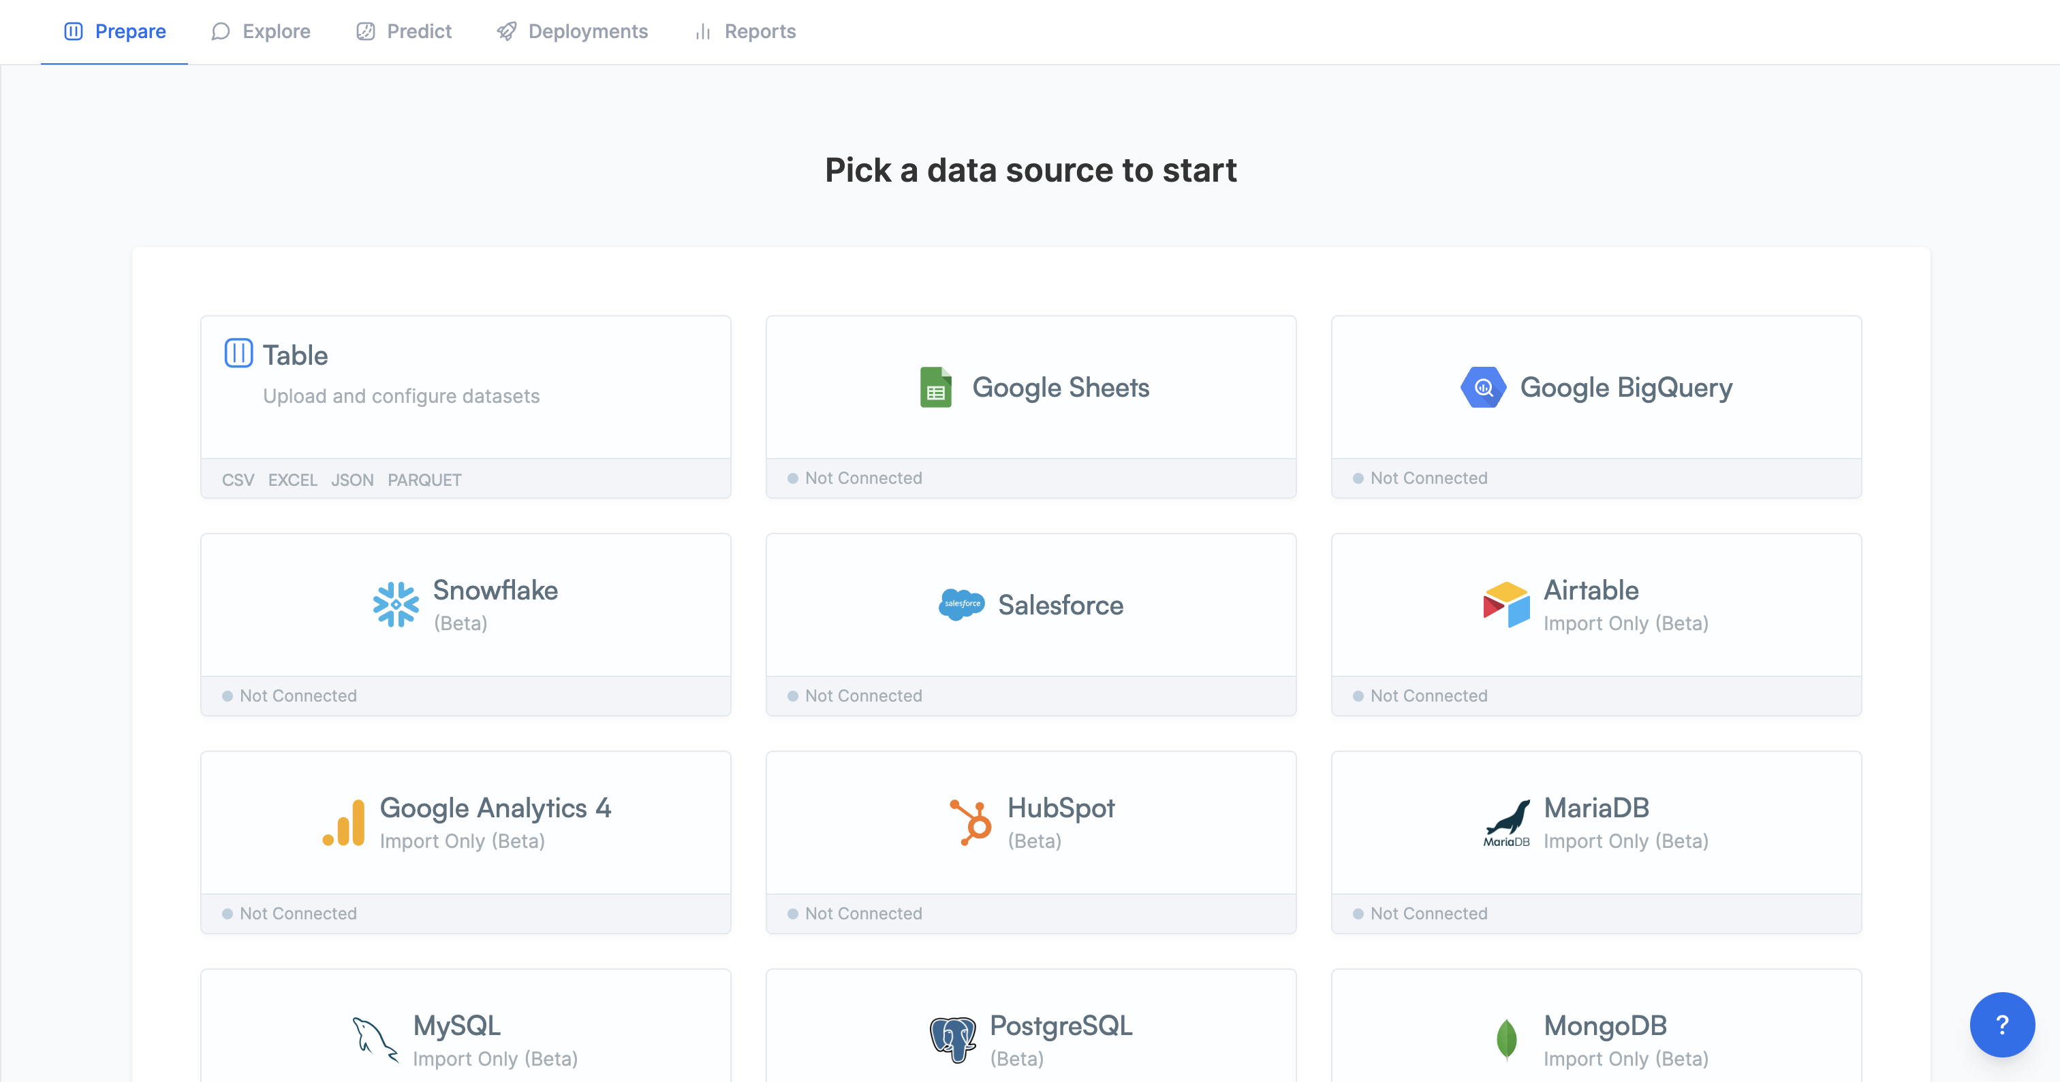

Slide 17

In my organization
Invite a user

Slide 18
Add your integrations to this space
To connect Tally download the Tally Plugin and follow the instructions. It may take few minutes to hours for the tally data to fully sync.

Slide 19
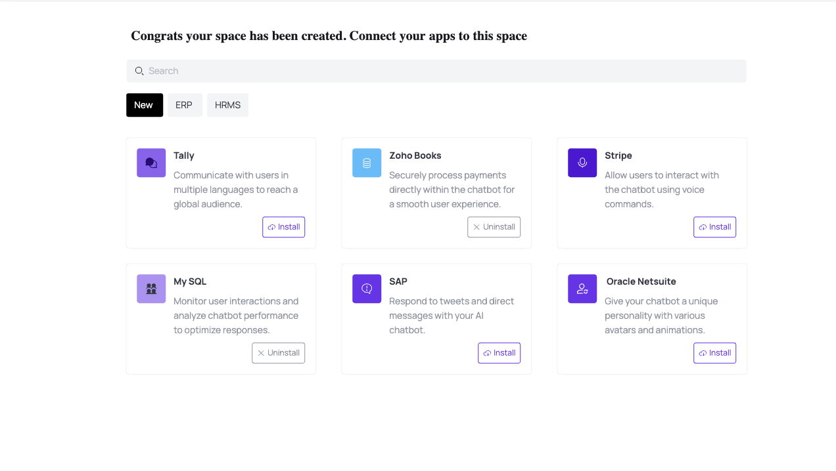
Connect your integrations to this space

Slide 20


My Spaces
Home
FMCG Sales
Sales
Legal
Project track
Advertising

Slide 21
Home feed
Aggregate feed from all spaces

Slide 22
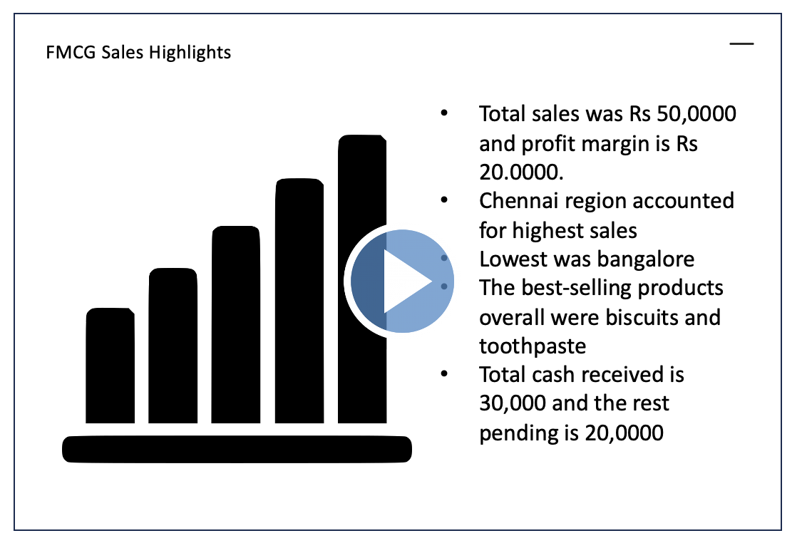
NDA contract received from ACME bank on email
30,000 new registered signed up on ACME platform out of which 2000 completed onboarding
Which city has the highest number of sales yesterday?
Search

Slide 23
Spaces
Spaces created by user ( we will deep dive into FMCG Space)

Slide 24
My Spaces
Home
FMCG Sales
Sales
Legal
Project track
Advertising

Slide 25
FMCG Space ( Search tab)
The first section is a AI-copilot which offers generative AI based search, can create charts, do analysis etc.

Slide 26


FMCG SPACE
Search
Dashboards
Apps
Which city has the highest number of sales yesterday
Hyderabad with a total sales of Rs 12 crore had the highest number of sales yesterday
Which city has the highest number of sales yesterday
Search

Slide 27
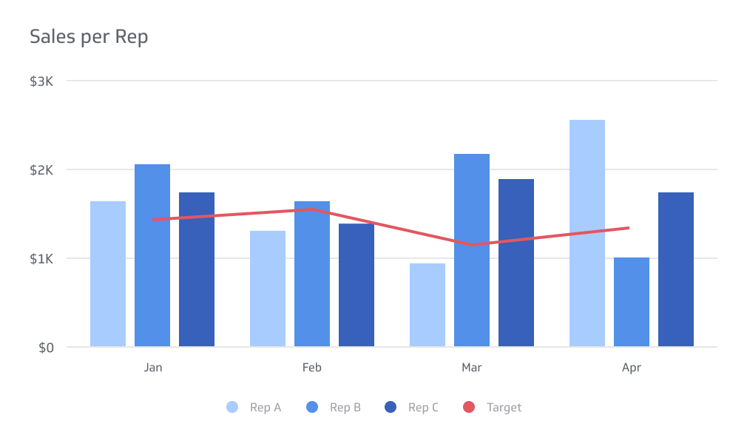
FMCG SPACE
Search
Dashboards
Apps
Which city has the highest number of sales yesterday
Hyderabad with a total sales of Rs 12 crore had the highest number of sales yesterday
Create a chart of the Top 5 Salesman in Hyderabad with their sales figures for the month
Create a chart of the Top 5 Sales man in Hyderabad with their sales figures for the month
Search

Slide 28
FMCG SPACE
Search
Dashboards
Apps
Whats the total profit margin for yesterday across india and which product accounted for the most margin?
The total profit margin for yesterday was Rs 85 lakhs. SVT washing powder accounted for the most margin with a margin of 15% accounting for almost 50% of the profit margin at Rs 42.5 lakhs
Whats the total profit margin for yesterday across india and which product accounted for the most margin
Search

Slide 29
FMCG Space ( Dashboard tab)
In this section user can create a dashboard using generative AI, PIN this dashboard

Slide 30
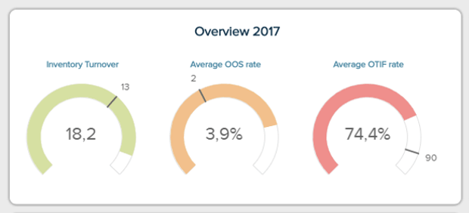
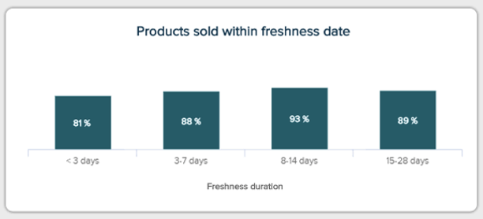
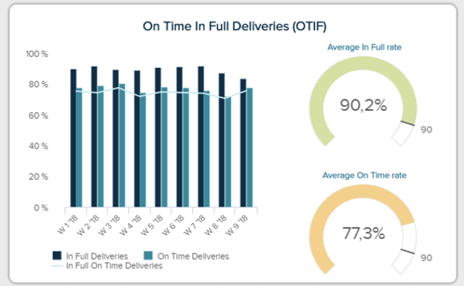
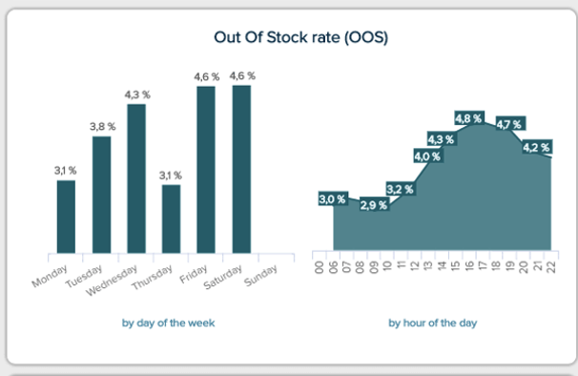
FMCG SPACE
 |  | Apps
Search
Dashboards
Create dashboard

Slide 31
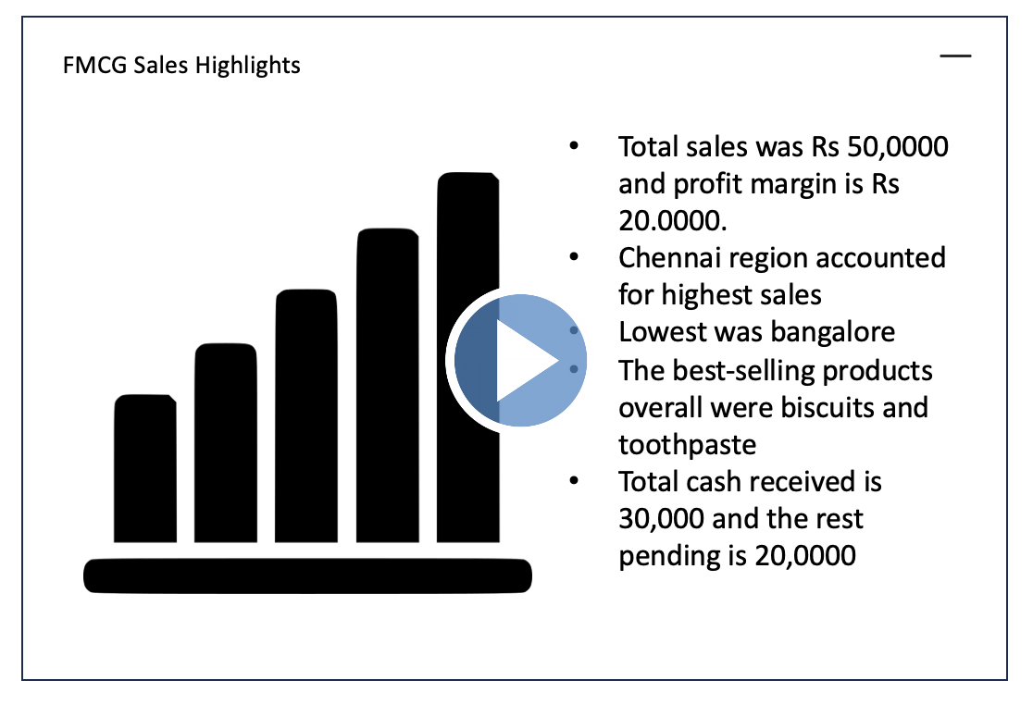
FMCG SPACE
 | Dashboards
Search
Search

Slide 32
FMCG Space ( Apps tab) – phase-2
In this section user can use different AI based productivity apps ( for example an app to generate an email content / or create a ppt slide)

Slide 33


FMCG SPACE
Search
Dashboards
Apps
Featured
Create professional presentations from your data
Fully personalized and automated outreach with an AI scheduler to book meetings for you.

Slide 34
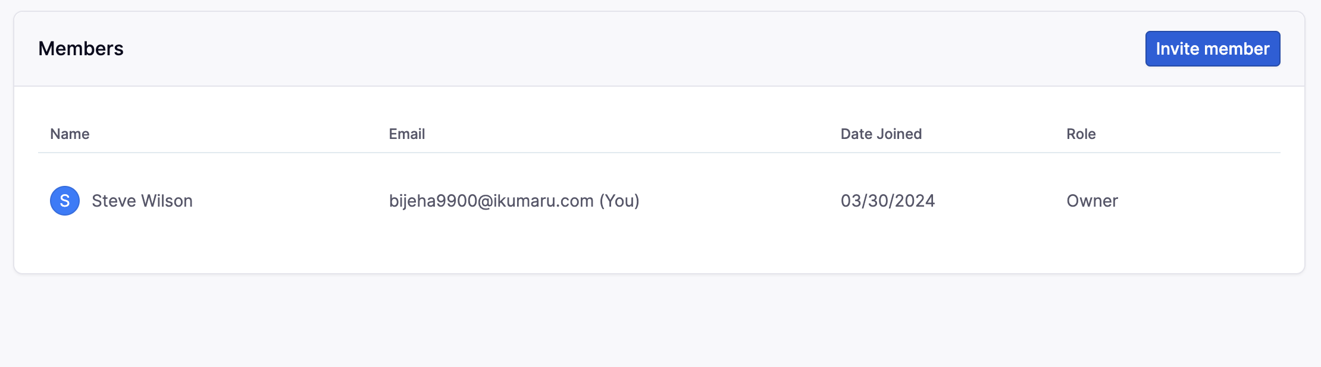
FMCG SPACE
Search
Dashboards
Apps
Space Settings
User roles & permissions
Integrations
Apps

Slide 35
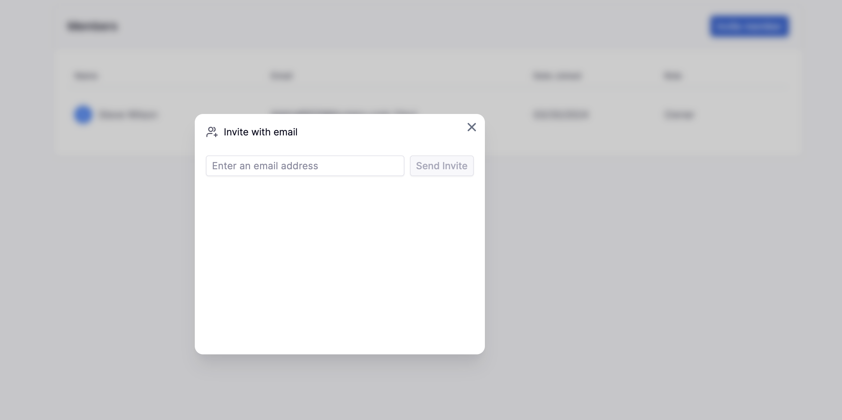
FMCG SPACE
Search
Dashboards
Apps
Space Settings
User roles & permissions
Integrations
Apps

Slide 36


FMCG SPACE
Search
Dashboards
Apps
Space Settings
Integrations
User roles & permissions
Integrations
Apps
Remove Integration
Remove Integration
Add integration

Slide 37
Settings

Slide 38
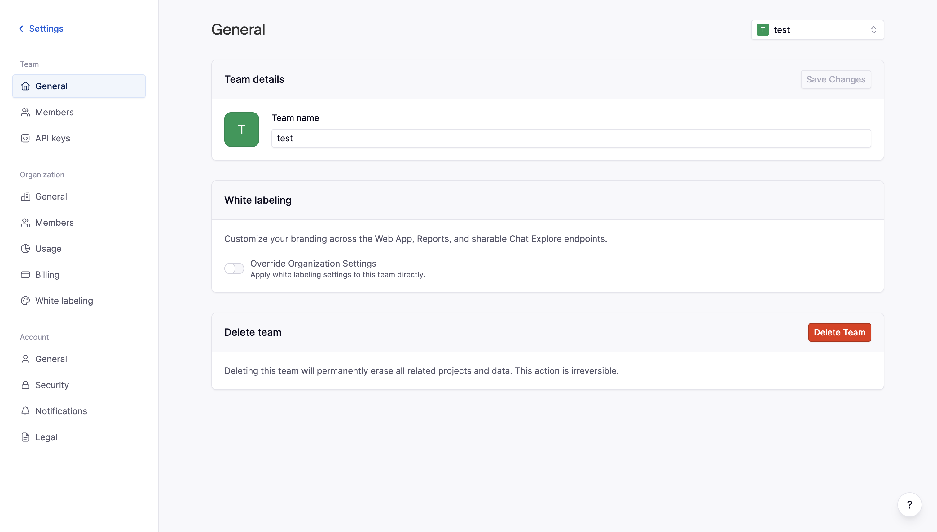
Search
Dashboards
Apps
Space Settings
Integrations
User roles & permissions
Integrations
Apps
Remove Integration
Remove Integration
Add integration

Slide 39
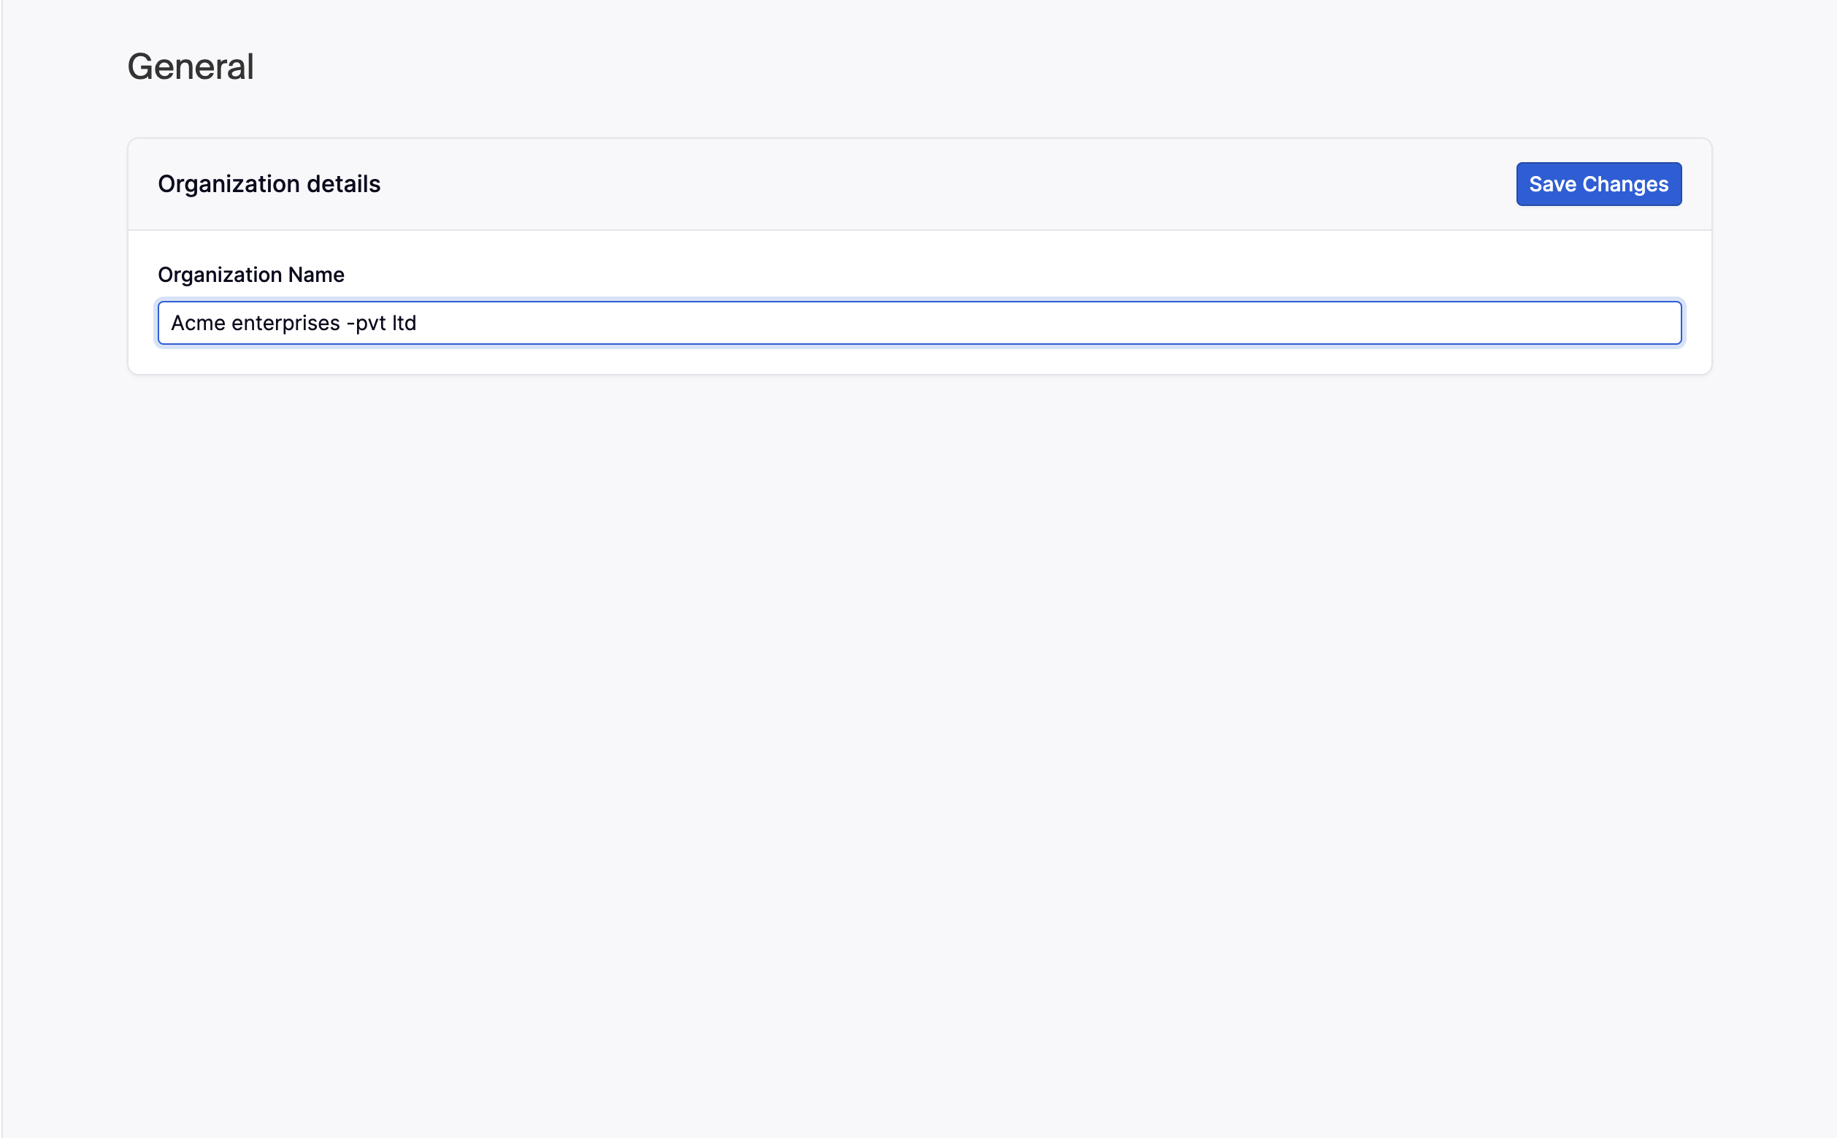
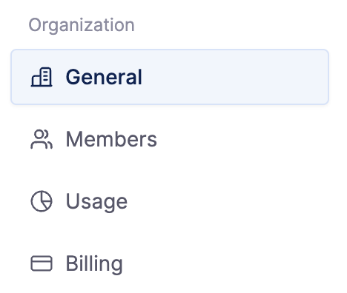
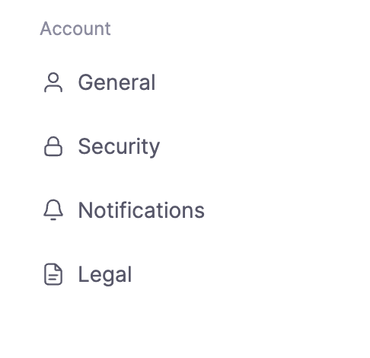
Settings
Search
Dashboards
Apps
Space Settings
Integrations
User roles & permissions
Integrations
Apps
Remove Integration
Remove Integration
Add integration

Slide 40
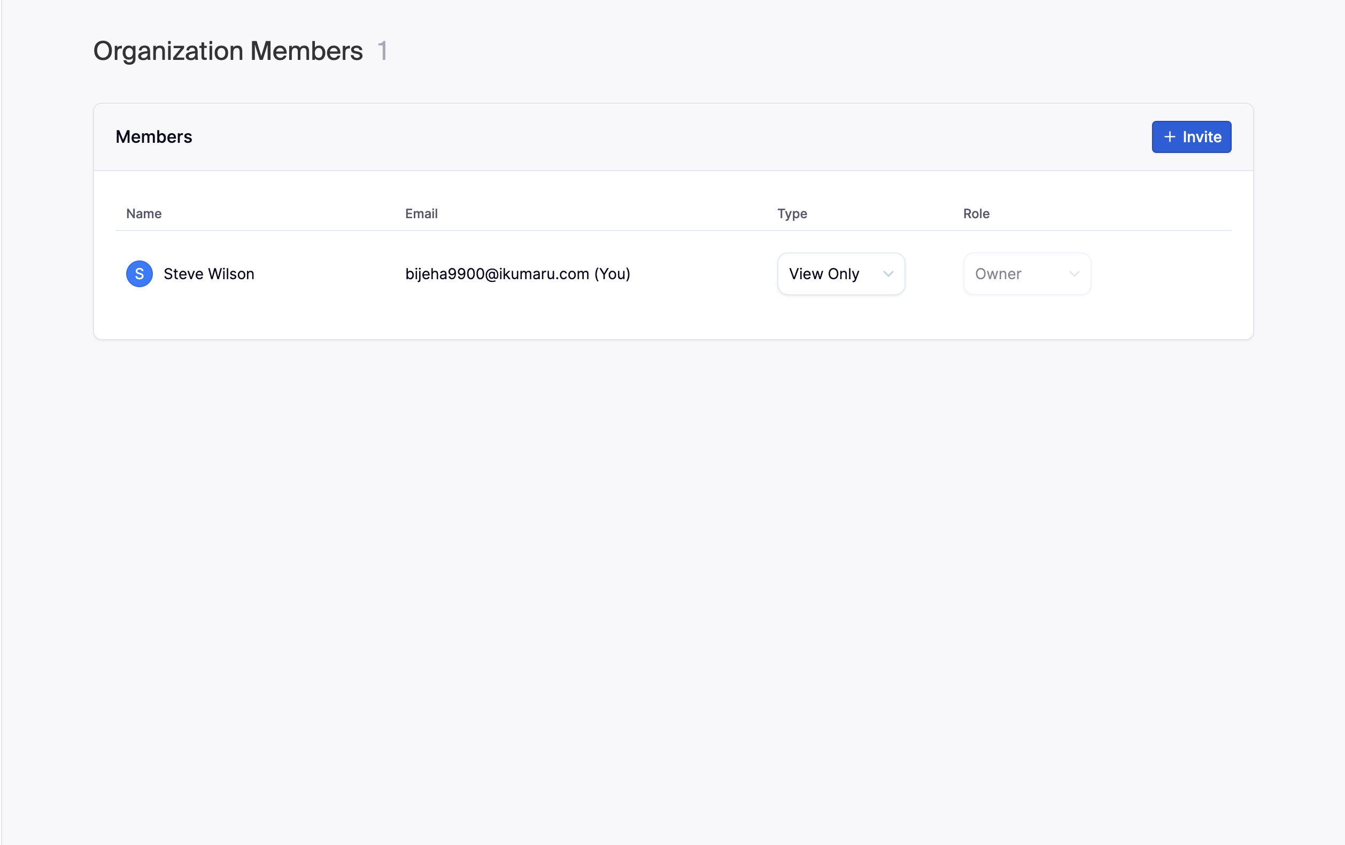
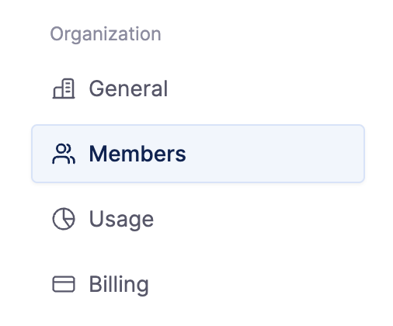
Settings
Search
Dashboards
Apps
Space Settings
Integrations
User roles & permissions
Integrations
Apps
Remove Integration
Remove Integration
Add integration

Slide 41
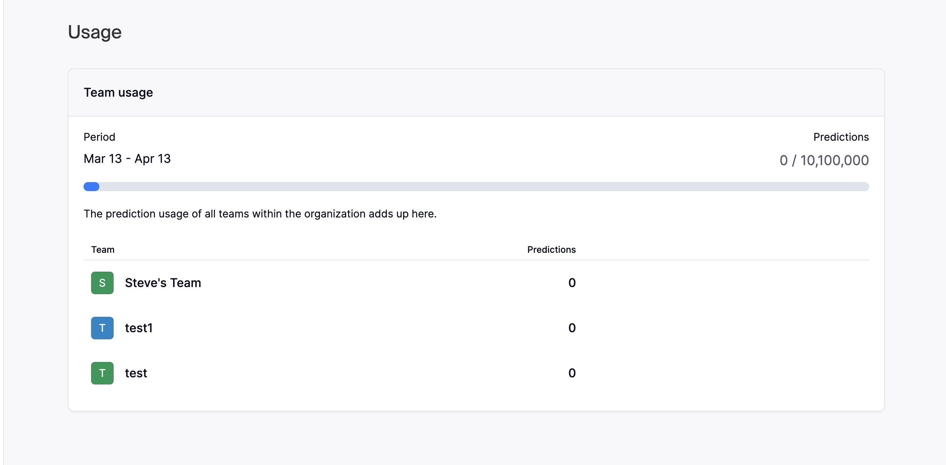
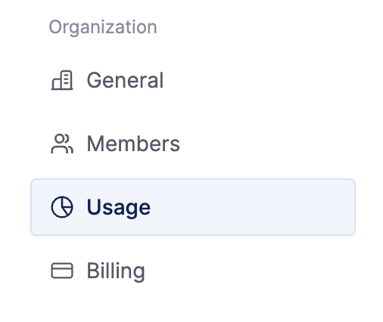
Settings
Search
Dashboards
Apps
Space Settings
Integrations
User roles & permissions
Integrations
Apps
Remove Integration
Remove Integration
Add integration

Slide 42
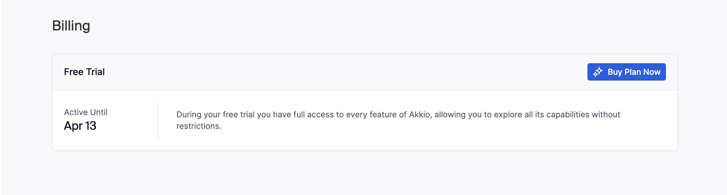
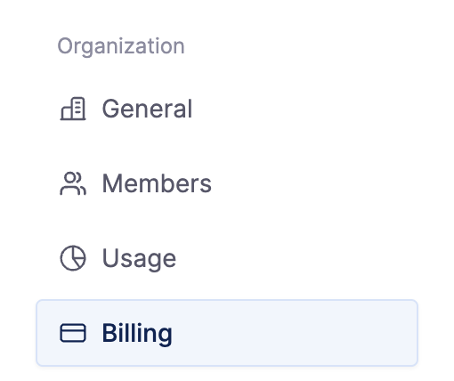
Settings
Search
Dashboards
Apps
Space Settings
Integrations
User roles & permissions
Integrations
Apps
Remove Integration
Remove Integration
Add integration

Slide 43
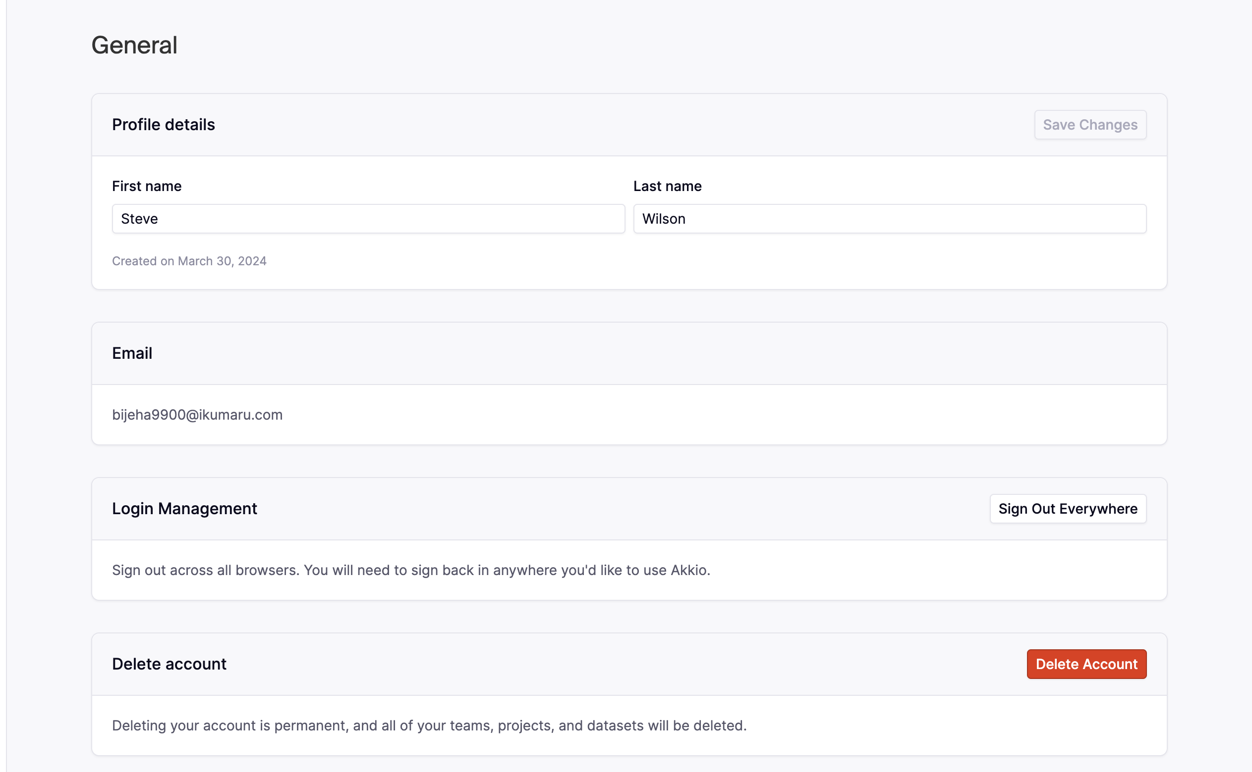
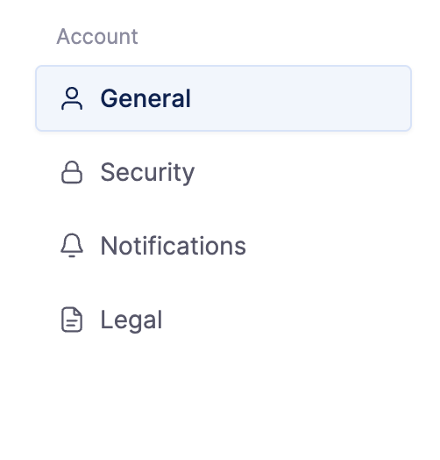
Settings
Search
Dashboards
Apps
Space Settings
Integrations
User roles & permissions
Integrations
Apps
Remove Integration
Remove Integration
Add integration

Slide 44
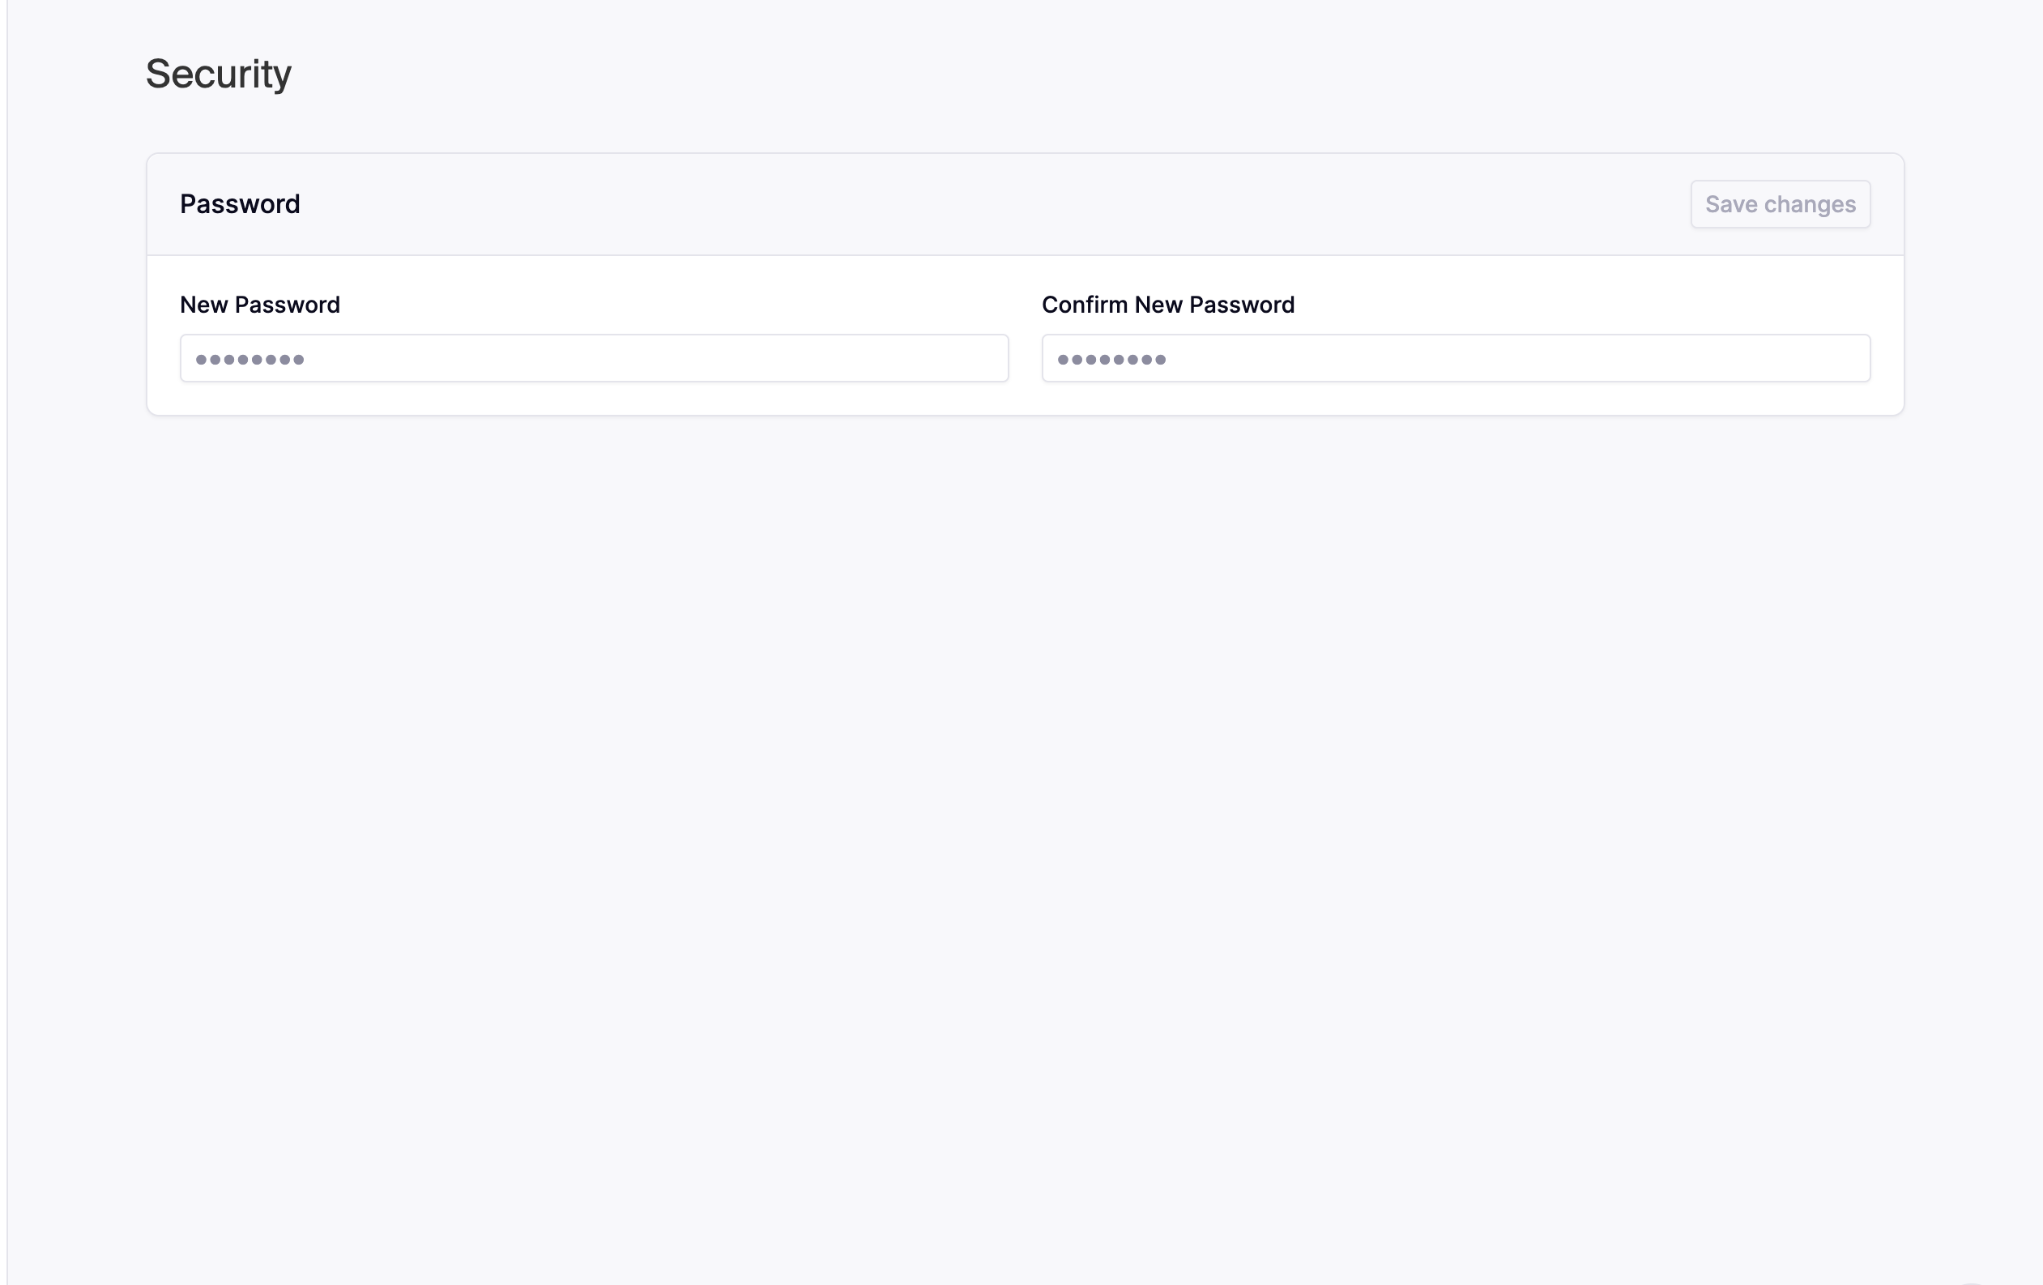
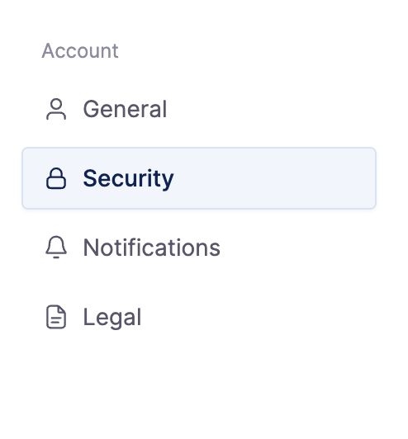
Settings
Search
Dashboards
Apps
Space Settings
Integrations
User roles & permissions
Integrations
Apps
Remove Integration
Remove Integration
Add integration

Slide 45
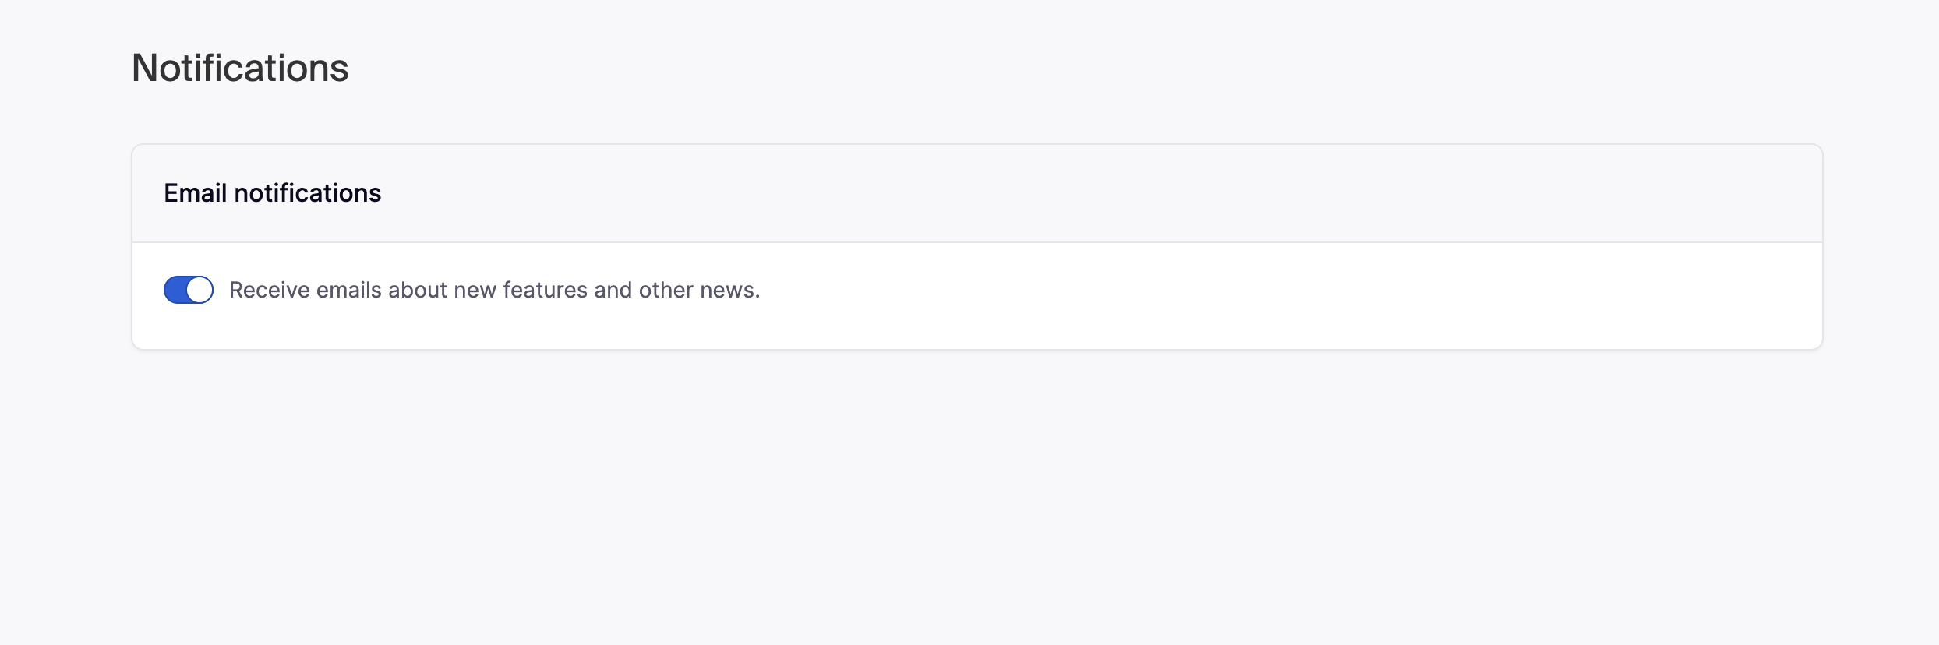
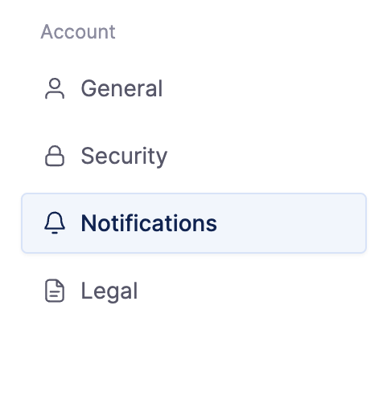
Settings
Search
Dashboards
Apps
Space Settings
Integrations
User roles & permissions
Integrations
Apps
Remove Integration
Remove Integration
Add integration

Slide 46
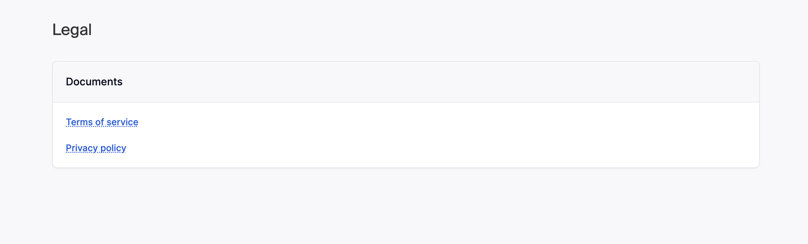
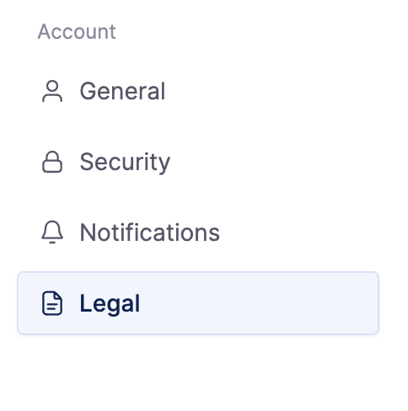
Settings
Search
Dashboards
Apps
Space Settings
Integrations
User roles & permissions
Integrations
Apps
Remove Integration
Remove Integration
Add integration

Slide 47
Product flow ( high level)
Register on hubspace.co
Signup for trial
Create first Space
- Give a name to the space
- Add integrations
Space
- Search
- Dashboards & Insights ( Create and pin)
- Apps ( Phase-2)

Slide 48
Ipaas API ( for connecting ERPs_
Alumio
Merge.dev
https://www.integrationlabs.co/
IPAAS platforms provide API connectivity to fetch data from external systems like ERP, CRM, HRMS etc

Slide 49
SAAS Boiler Plate
https://usegravity.app/

Slide 50
LLM /AI Model
To be discussed

